Slide 1




Management Summary Facts & figures of Formnext
17 – 20 Nov 2026
FRANKFURT / GERMANY
Honorary sponsor

Slide 2
Hub for Additive Manufacturing
Year-round partner to the industry:
AM content and AM events
365 days a year, formnext.com
Industry hub including
AM Directory
Formnext Magazine
AM4U newsletter
Newsroom
Formnext.TV
AM Field Guide
Seminars & DeepDives
Formnext Technology Talks
Formnext Whitepapers
AM Jobs
AM event calendar
Formnext events worldwide
17 – 20 November 2026, Frankfurt / Germany
Leading global exhibition
dedicated to Additive Manufacturing / industrial 3D Printing
804 exhibitors present their products from the entire process chain of AM
38,282 professionals and managers of all manufacturing industries are visitors of Formnext
Industry Insights & Events
Expo & Convention

Slide 3
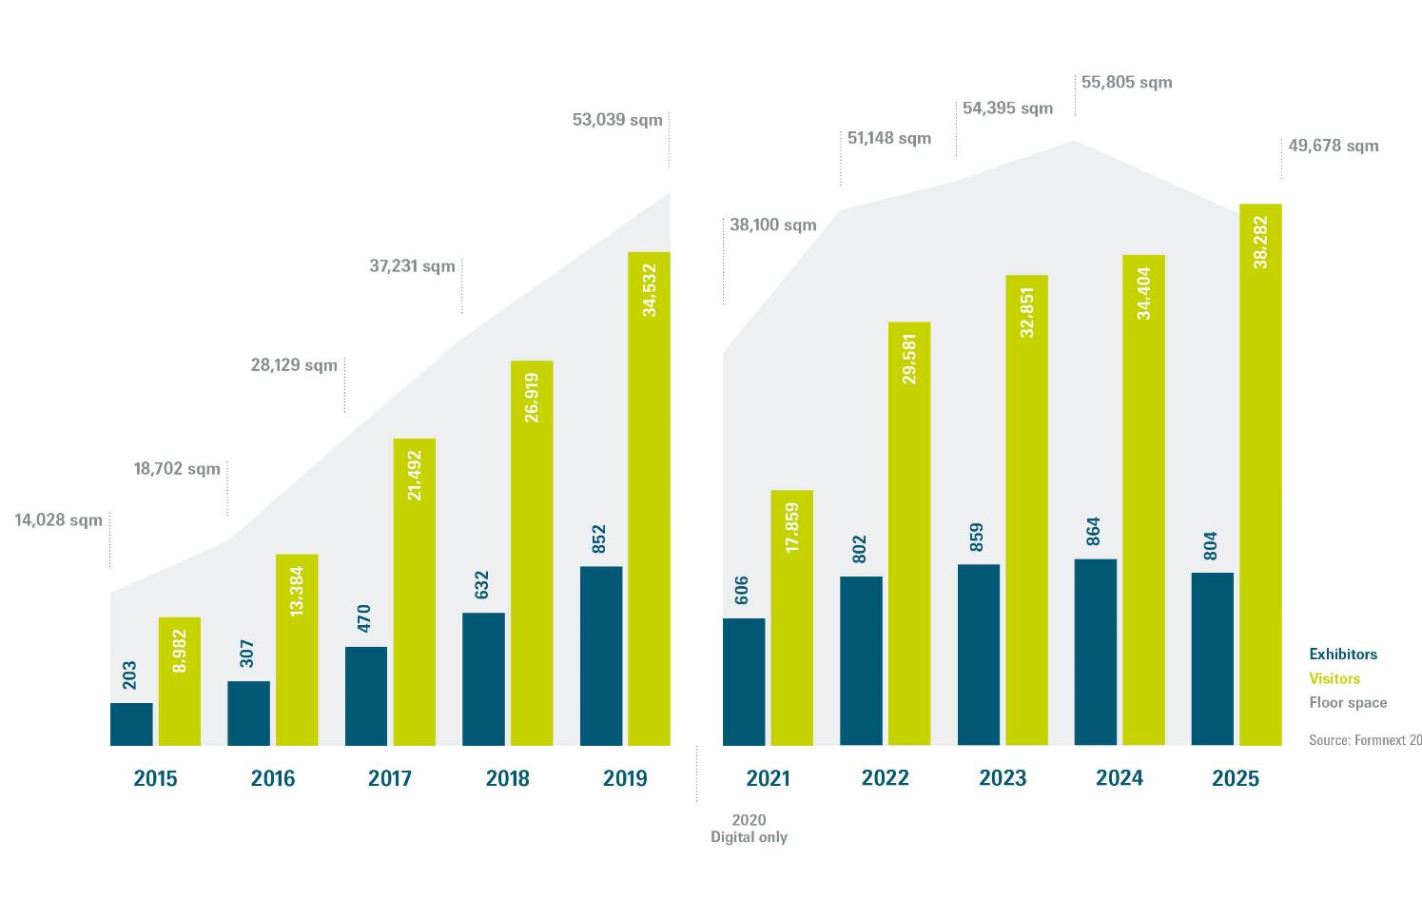
Growth of Formnext
Source: Formnext 2025

Slide 4
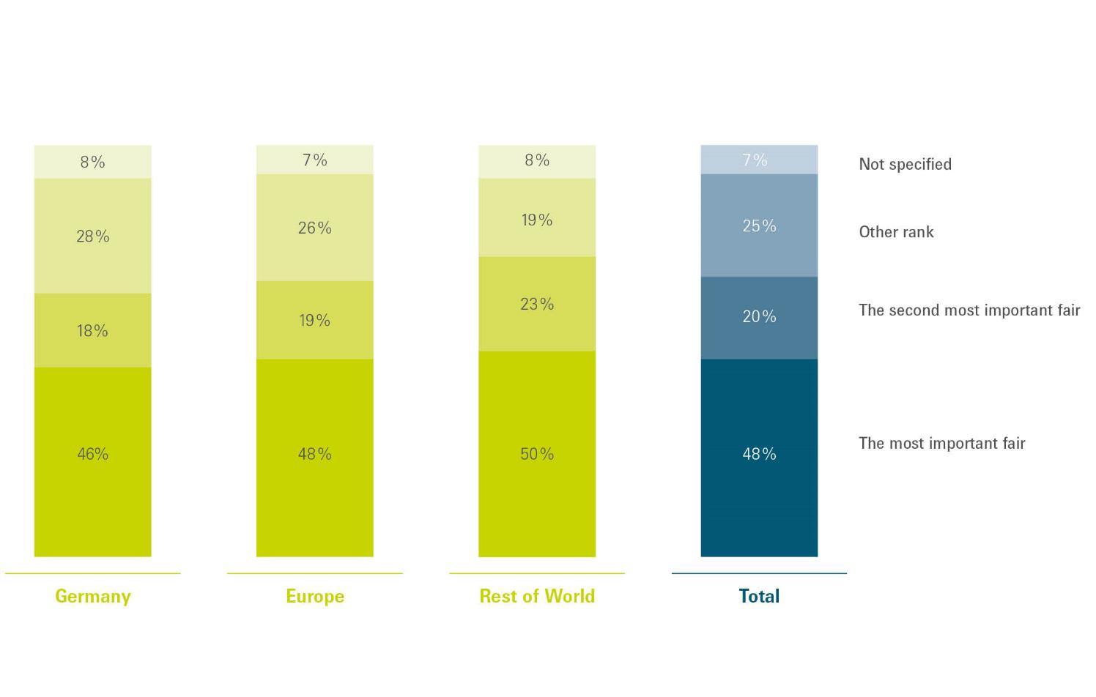
Ranking in international trade fair comparison
Source: Exhibitor survey Formnext 2025

Slide 5
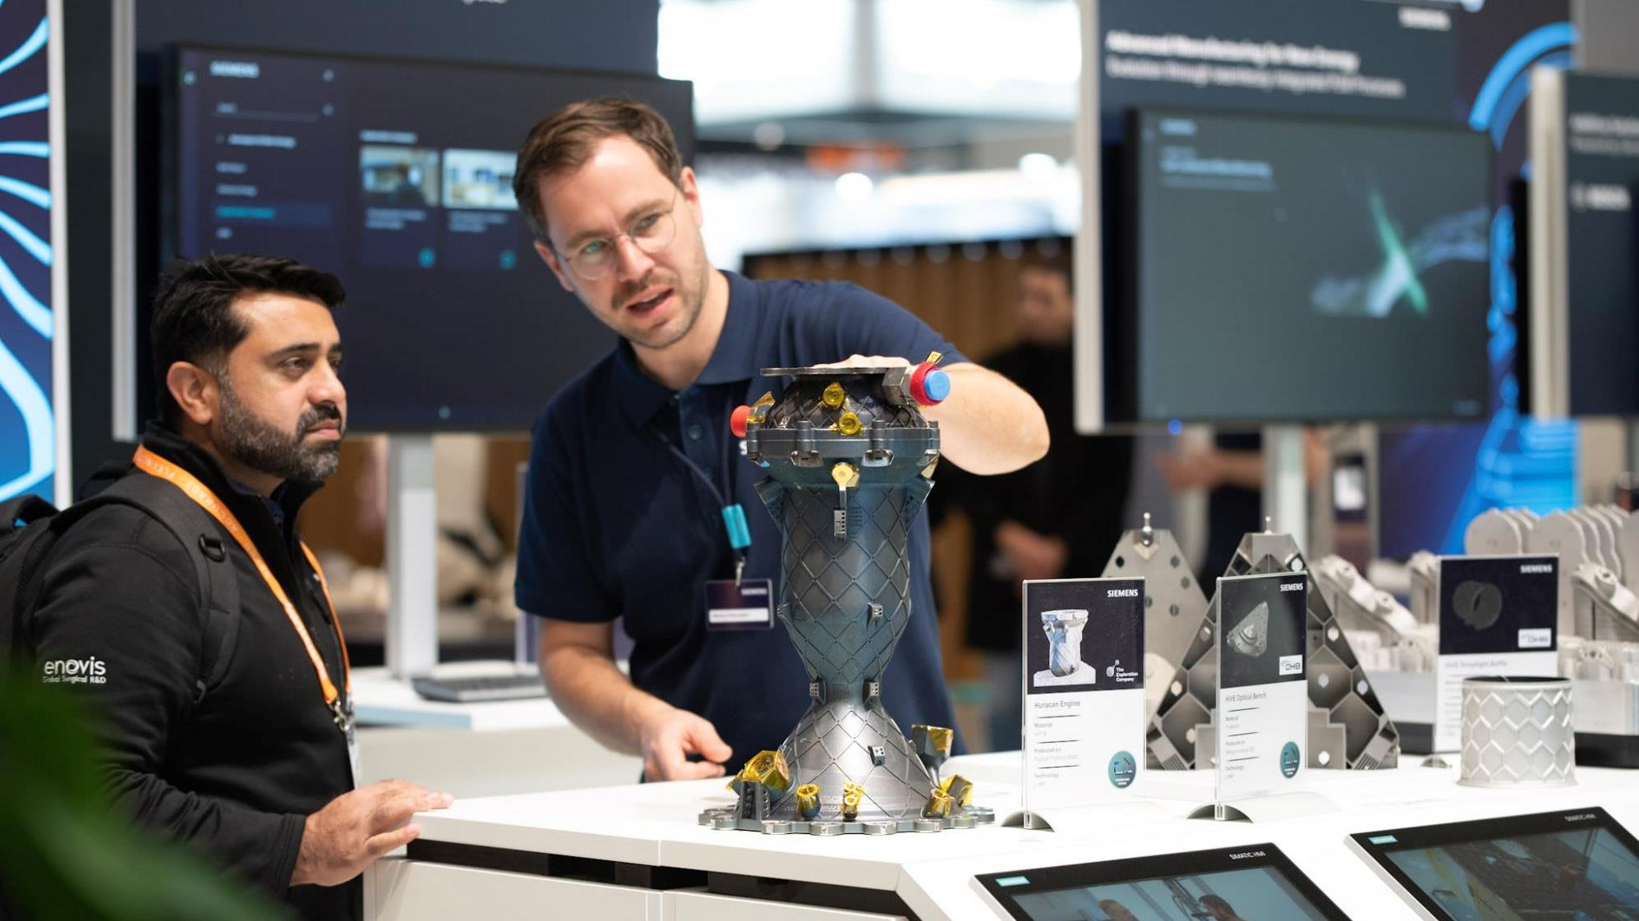
of exhibitors are satisfied to very satisfied with their participation at Formnext.
88
%
Source: Exhibitor survey Formnext 2025

Slide 6
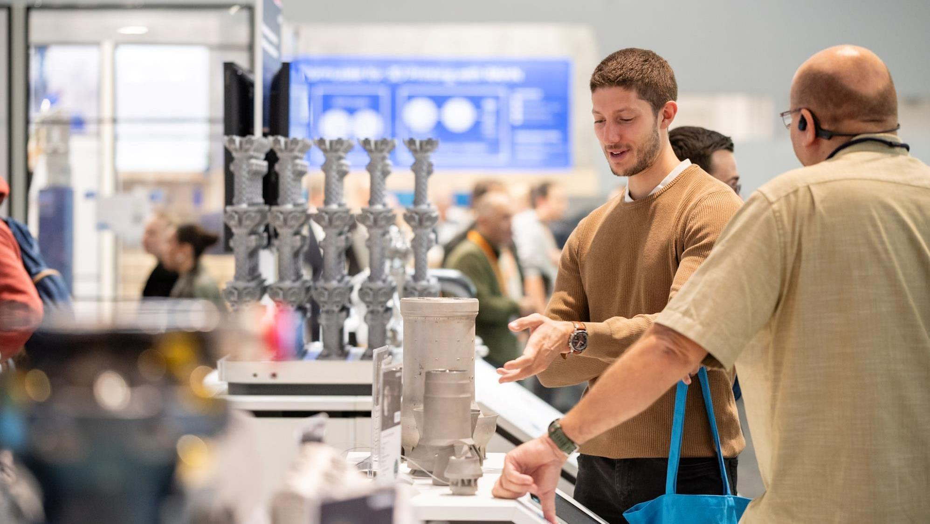
of visitors are satisfied to very satisfied with their attendance at Formnext.
96
%
Source: Visitor survey Formnext 2025

Slide 7
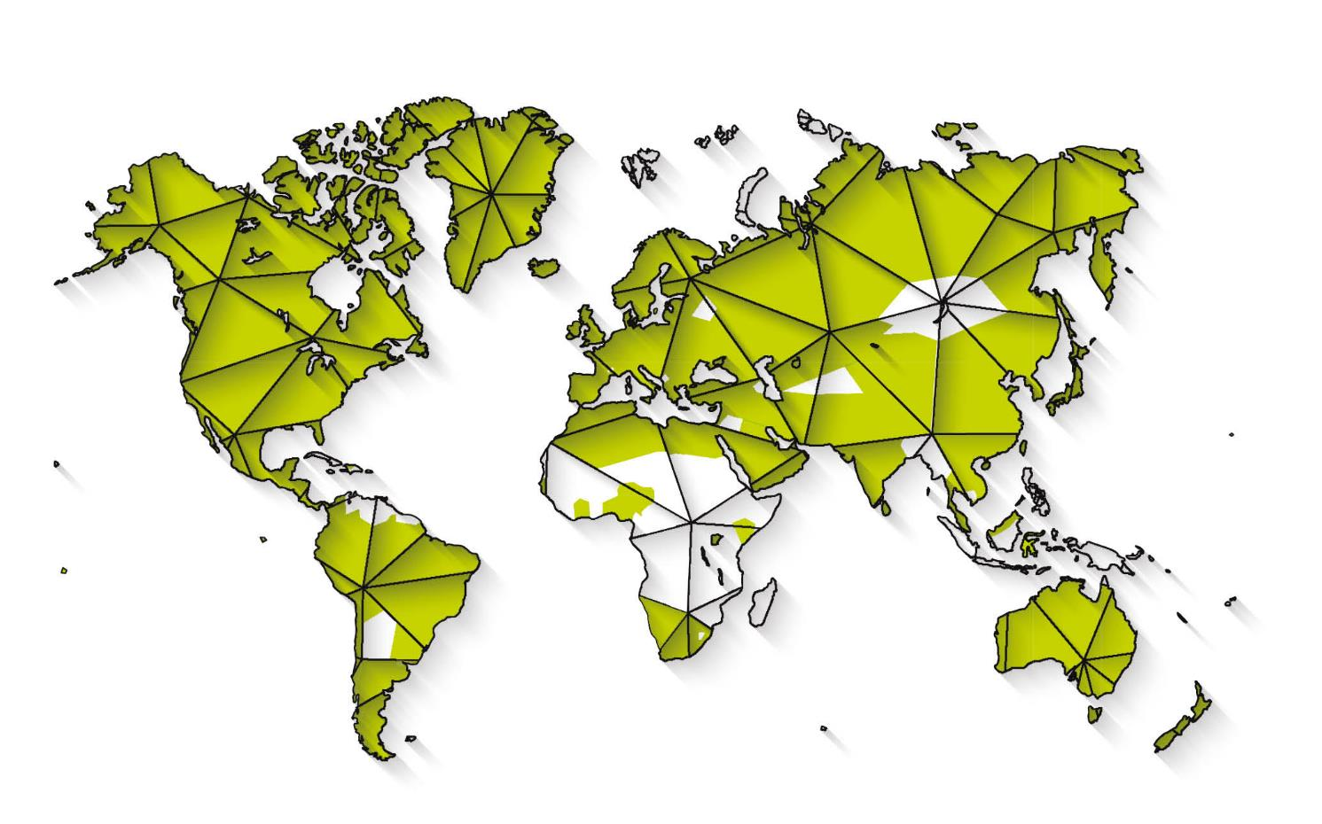
Origin of visitors –
by countries
Source: Formnext 2025

Slide 8
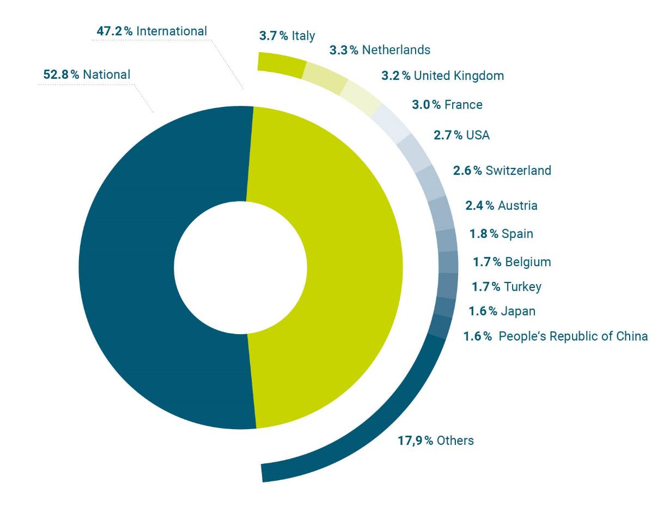
Origin of visitors –
top 12 nations
Source: Formnext 2025

Slide 9
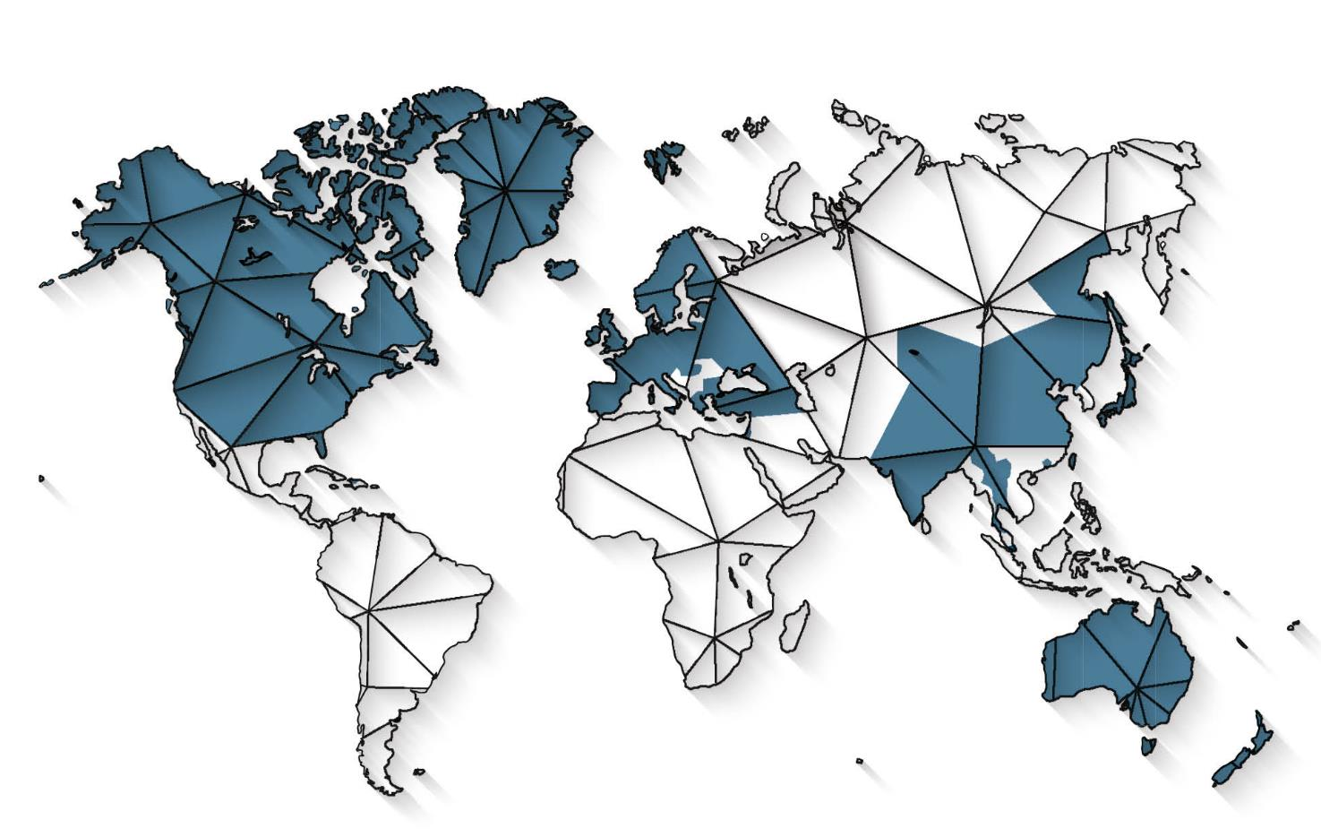
Origins of exhibitors – by countries
Source: Formnext 2025

Slide 10
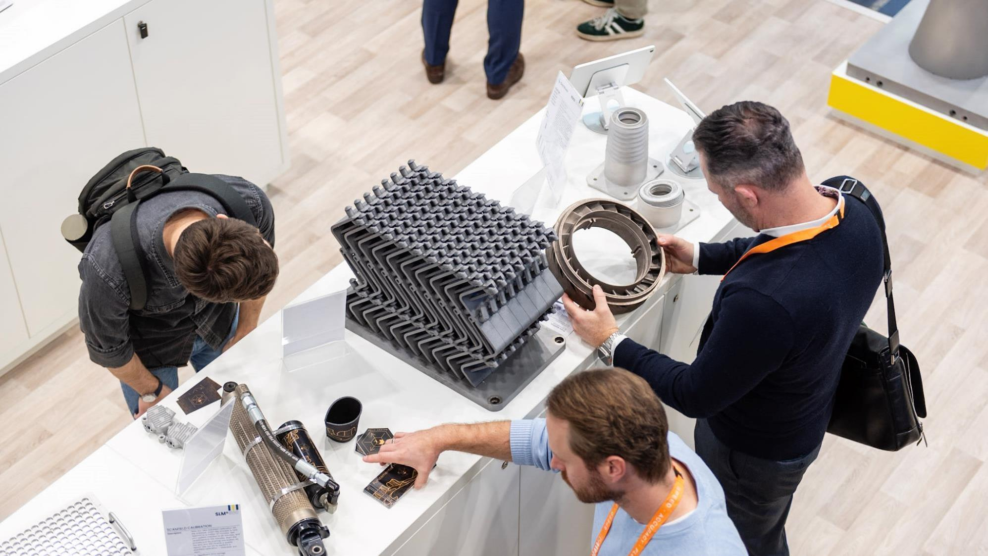
of exhibitors are satisfied to very satisfied with reaching their target visitor group.
80
%
Source: Exhibitor survey Formnext 2025

Slide 11
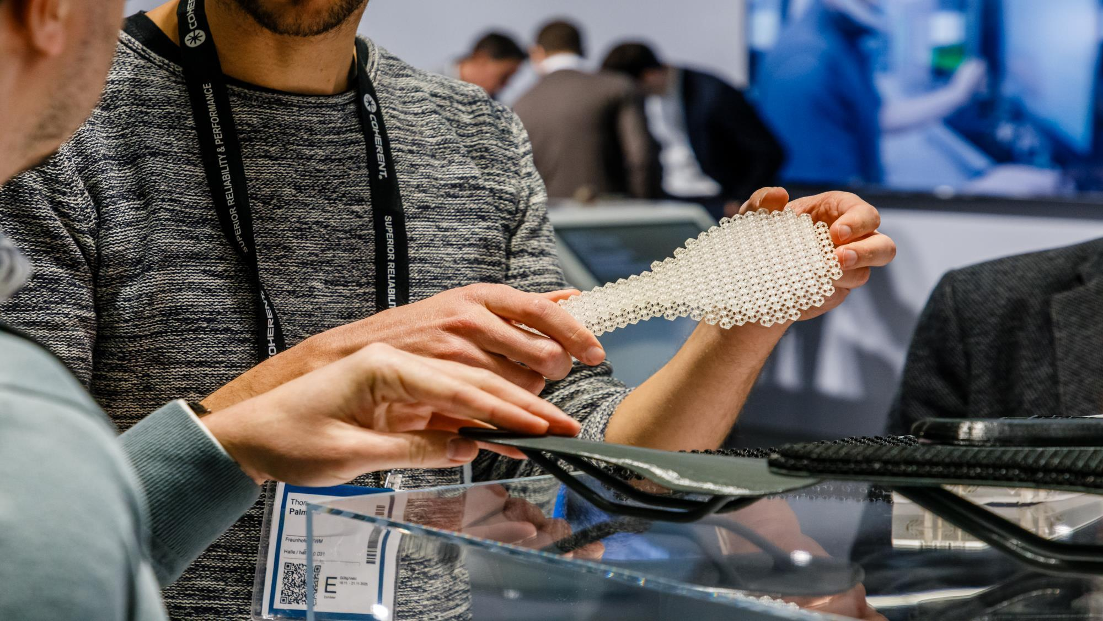
of visitors are satisfied to very satisfied with the achievement of exhibition visit objectives.
96
%
Source: Visitor survey Formnext 2025

Slide 12
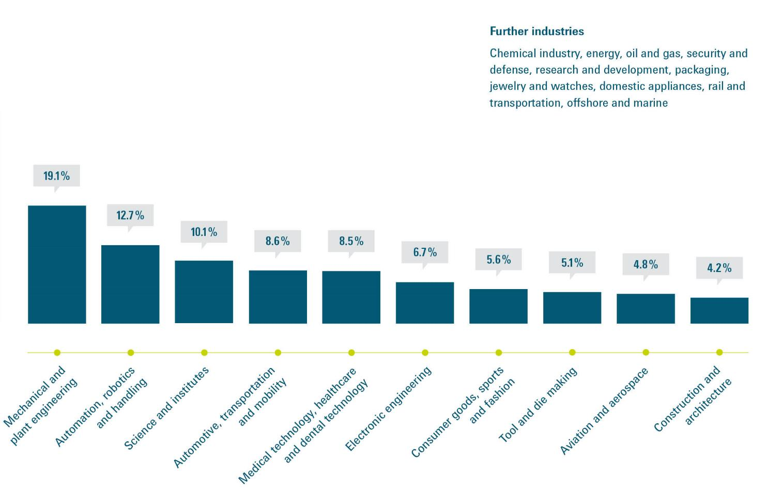
Top 10
user industries
Source: Formnext 2025

Slide 13
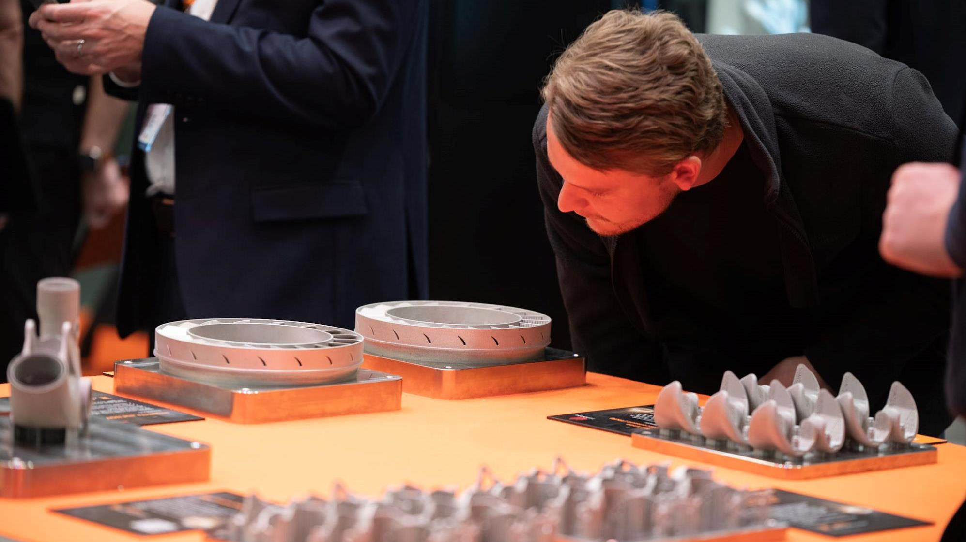
of visitors rate the benefits of their visit to Formnext to their professional or business activities as high to very high.
89
%
Source: Visitor survey Formnext 2025

Slide 14
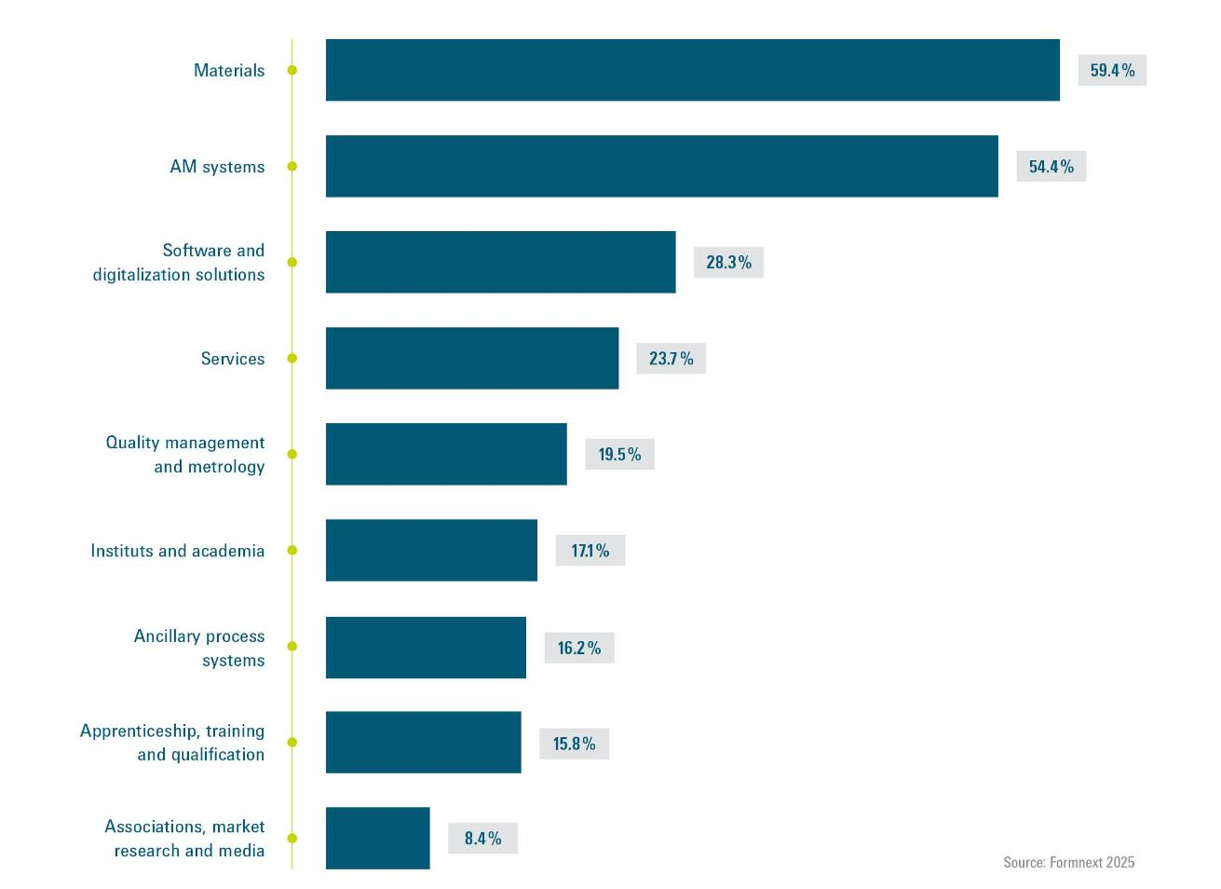
Visitor interest in portfolio
91-92%
Satisfaction rate of visitors with the range of exhibits, innovations and brand presence
Source: Formnext 2025
(multiple answers possible)

Slide 15
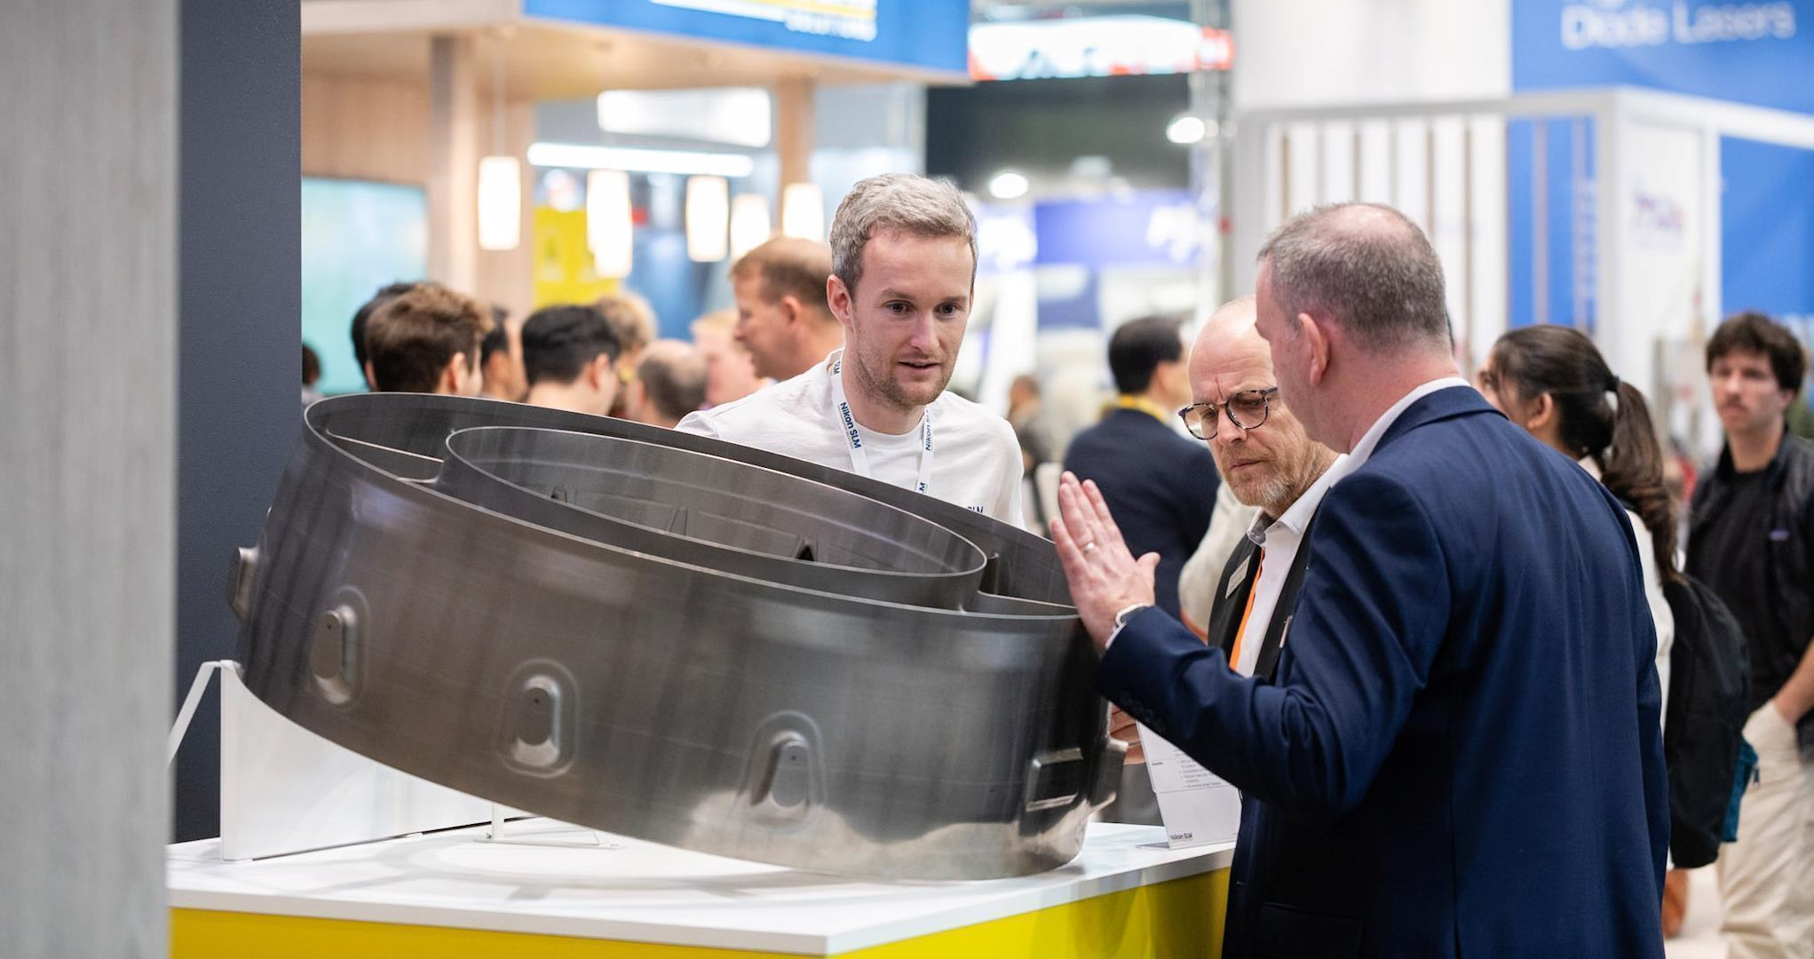
of visitors are decision-makers.
63
%
Source: Visitor survey Formnext 2025

Slide 16
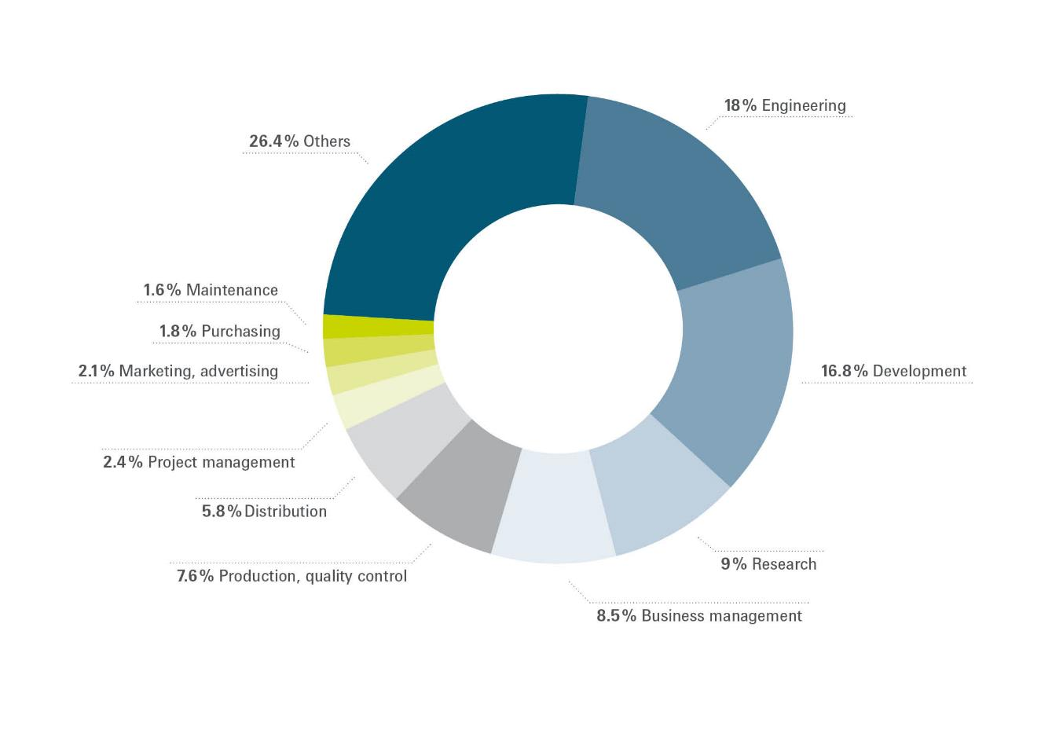
Top 10
fields of responsibility within the company
Source: Formnext 2025

Slide 17
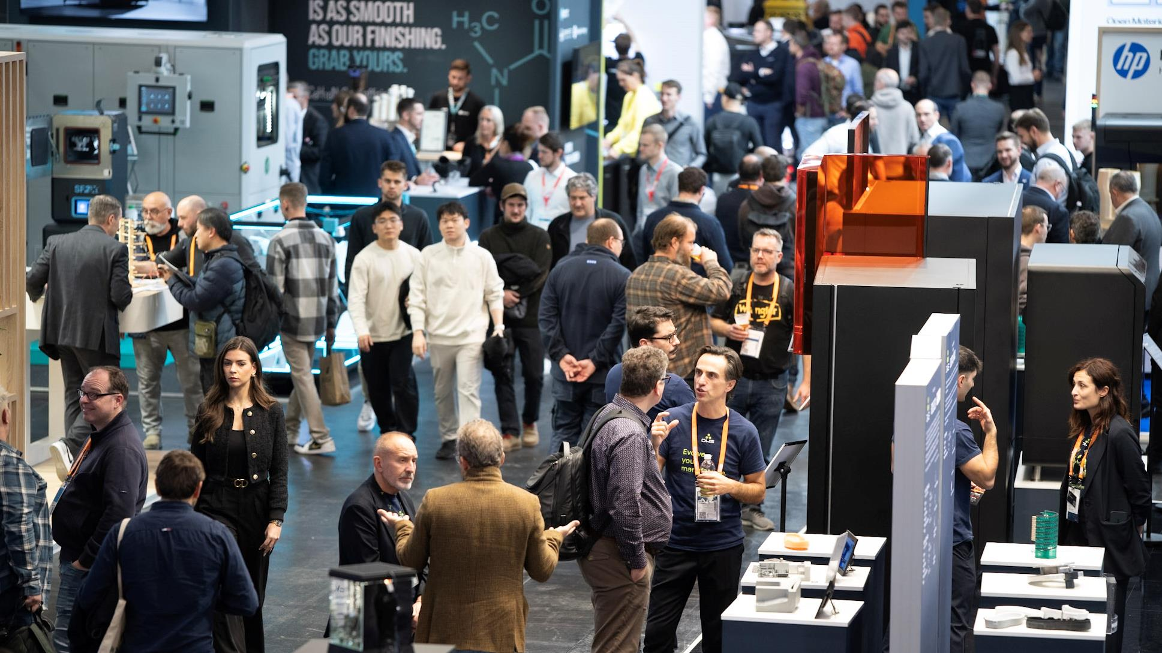
of visitors strongly or are extremely likely to recommend Formnext to business friends or colleagues.
90
%
Source: Visitor survey Formnext 2025

Slide 18
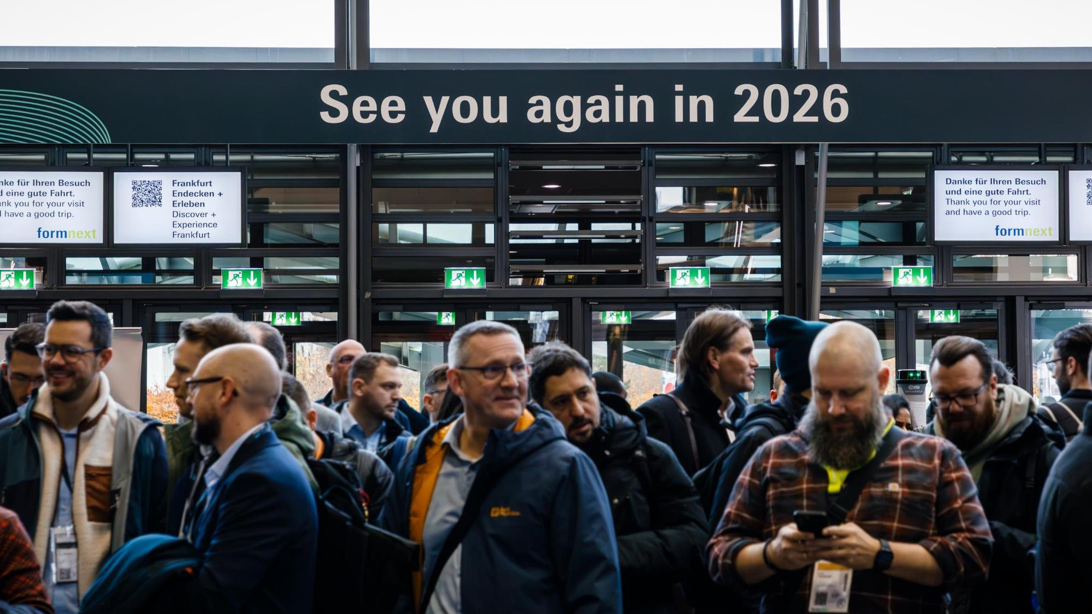
85
%
of visitors intend
to return.
Source: Visitor survey Formnext 2025

Slide 19
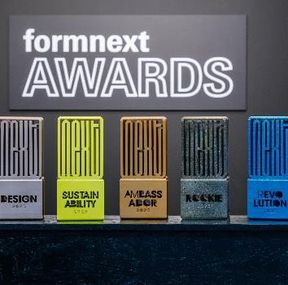
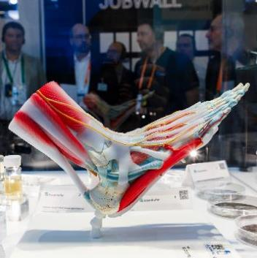
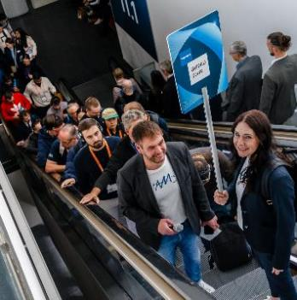
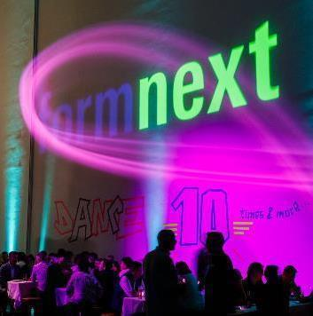
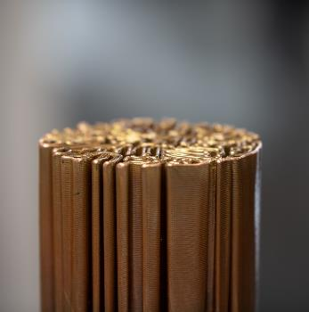
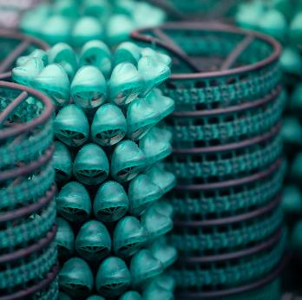
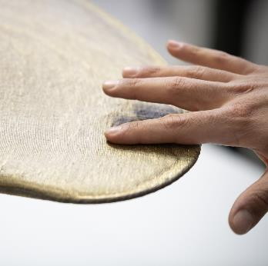
Any questions? Contact us: André Rau request.formnext@mesago.com +49 711 61946 157

Slide 20
