Slide 1
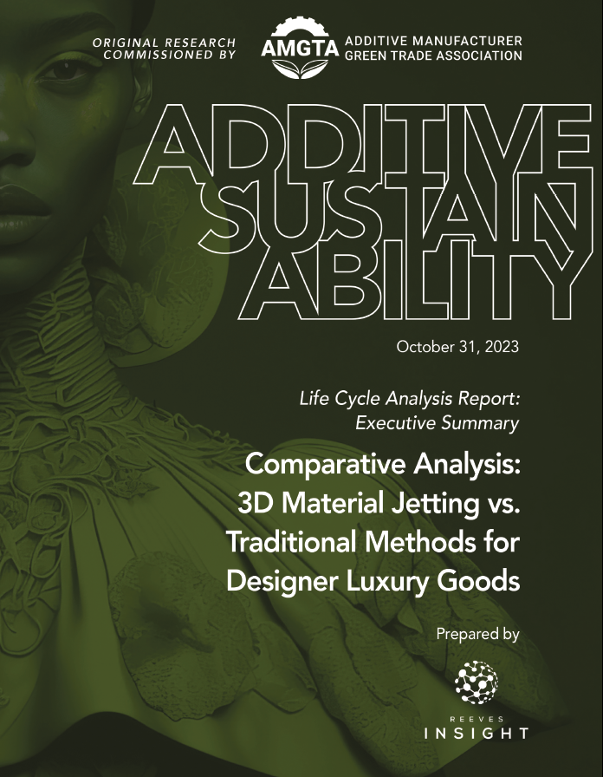
Fashion Life Cycle Analysis Quantify Stratasys Sustainable Value for Customers

Slide 2
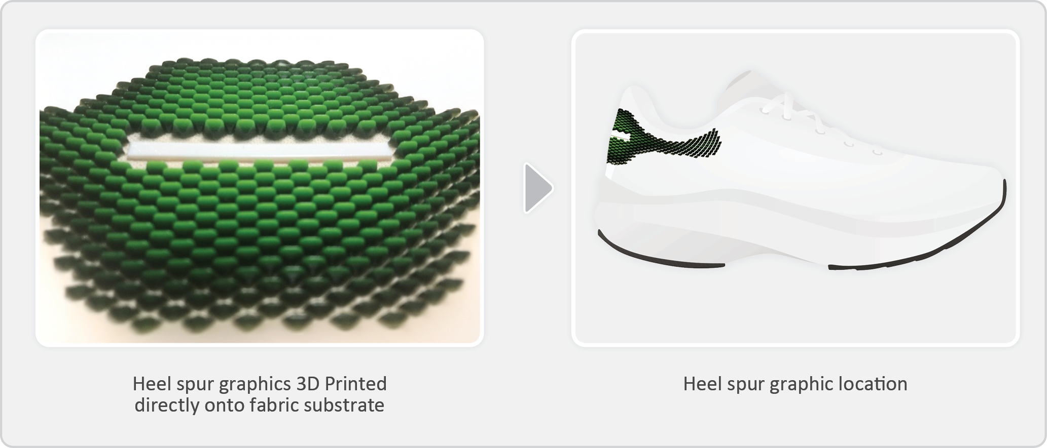
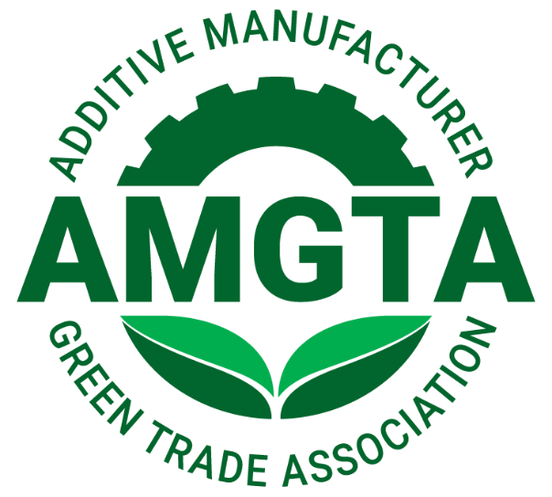
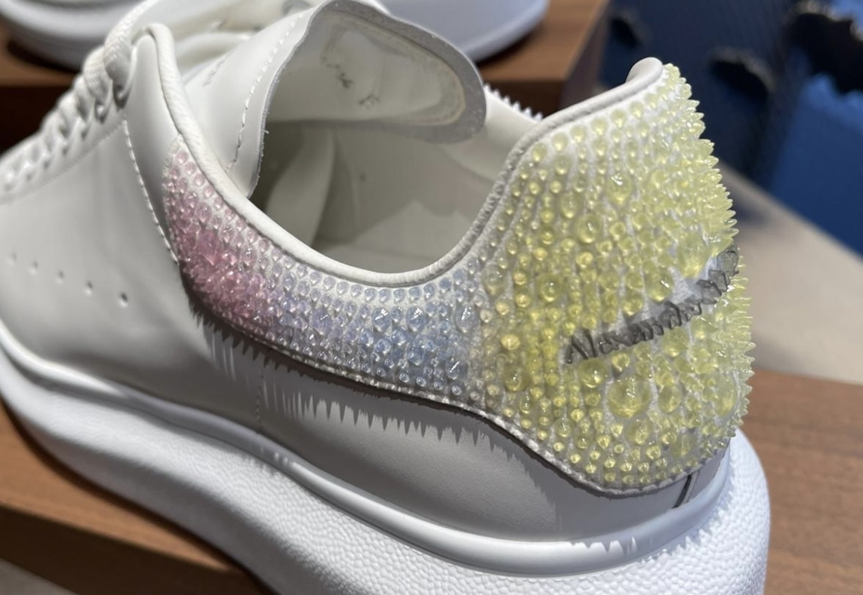
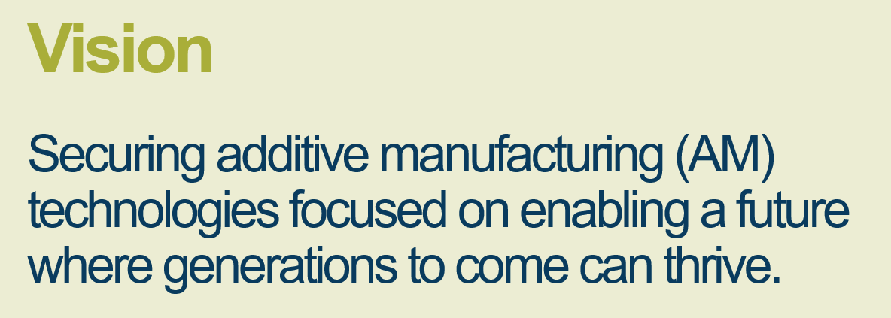
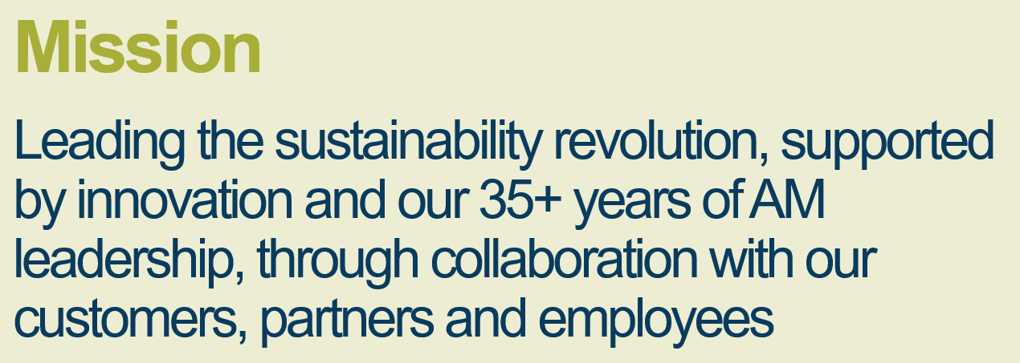
Stratasys is Committed to Mindful Manufacturing™ We embed ESG practices across our portfolio to promote evidence- based sustainability practices
Life Cycle Inventory Assessment:
Comparative Analysis of 3D Material Jetting and Traditional Methods for Designer Applique Component
Analysis Performed by:
Peer Reviewed by:
Customer Use Case & Partnership:

Slide 3
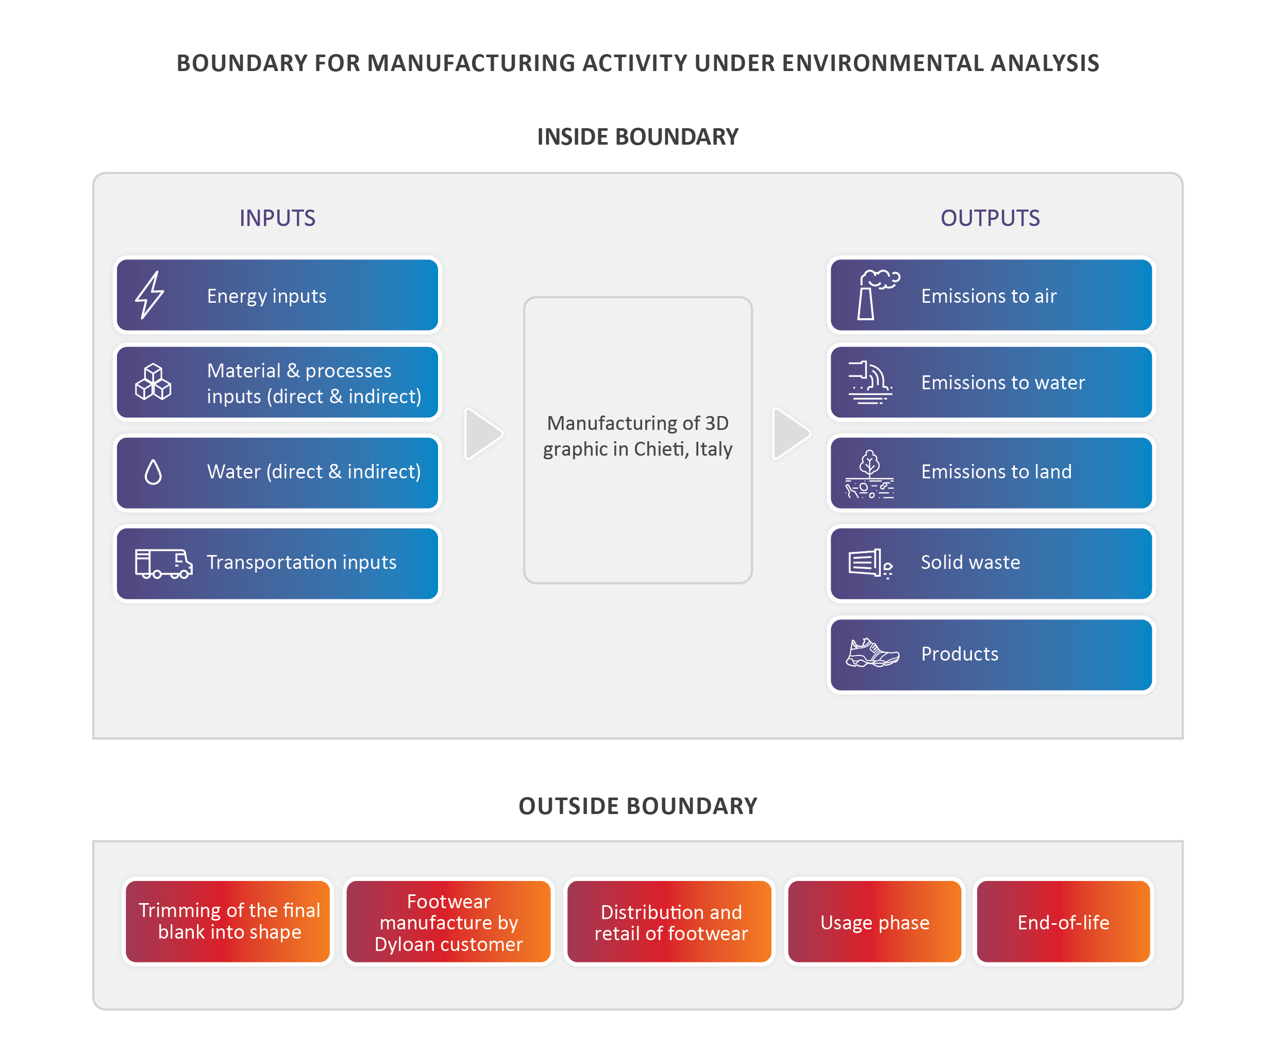
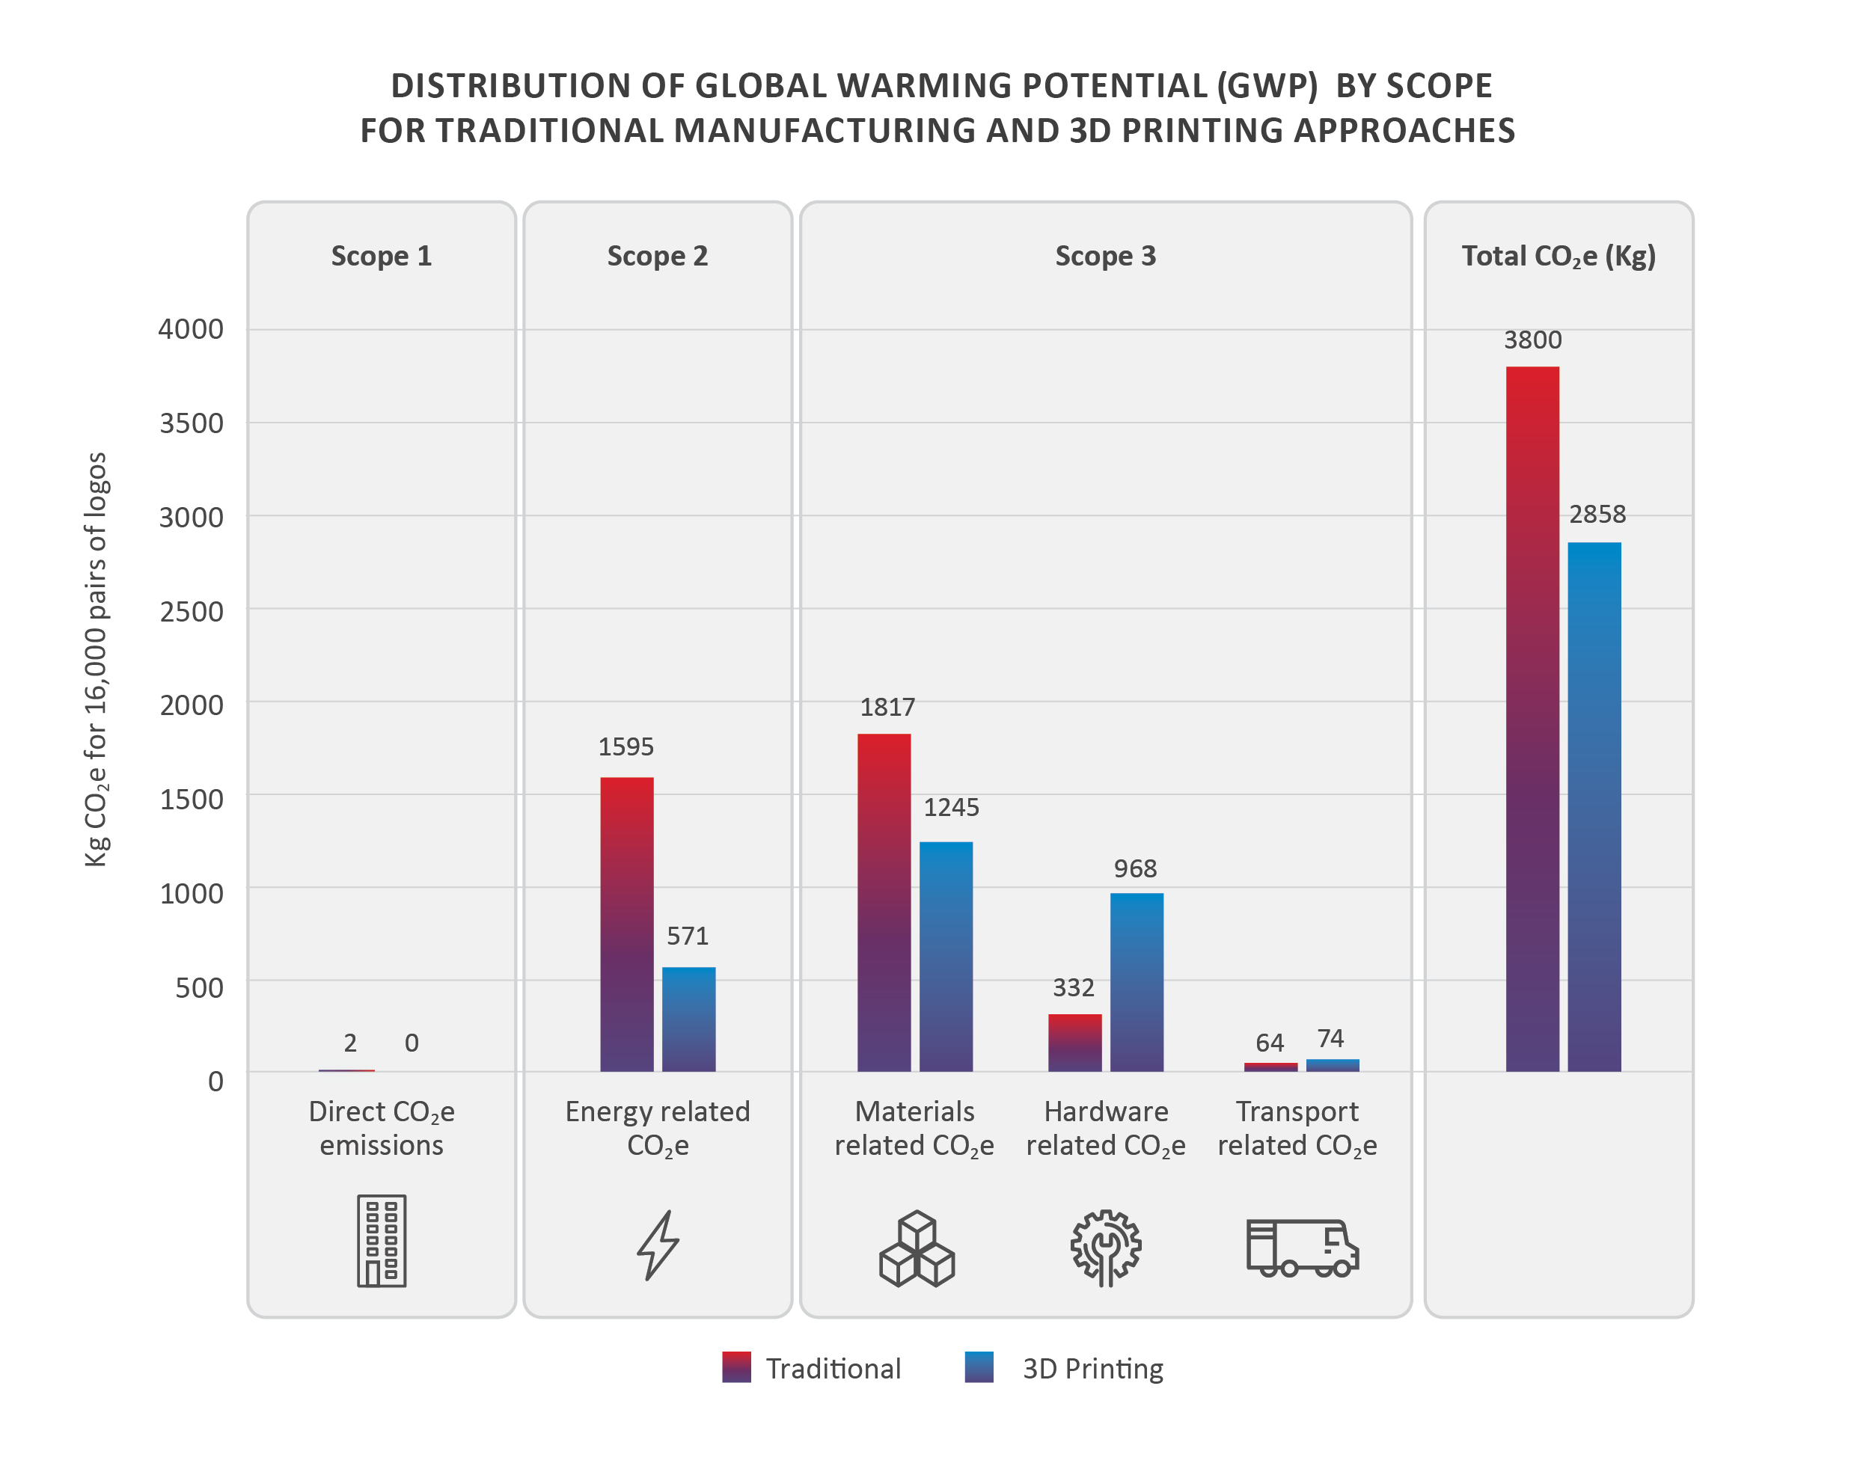
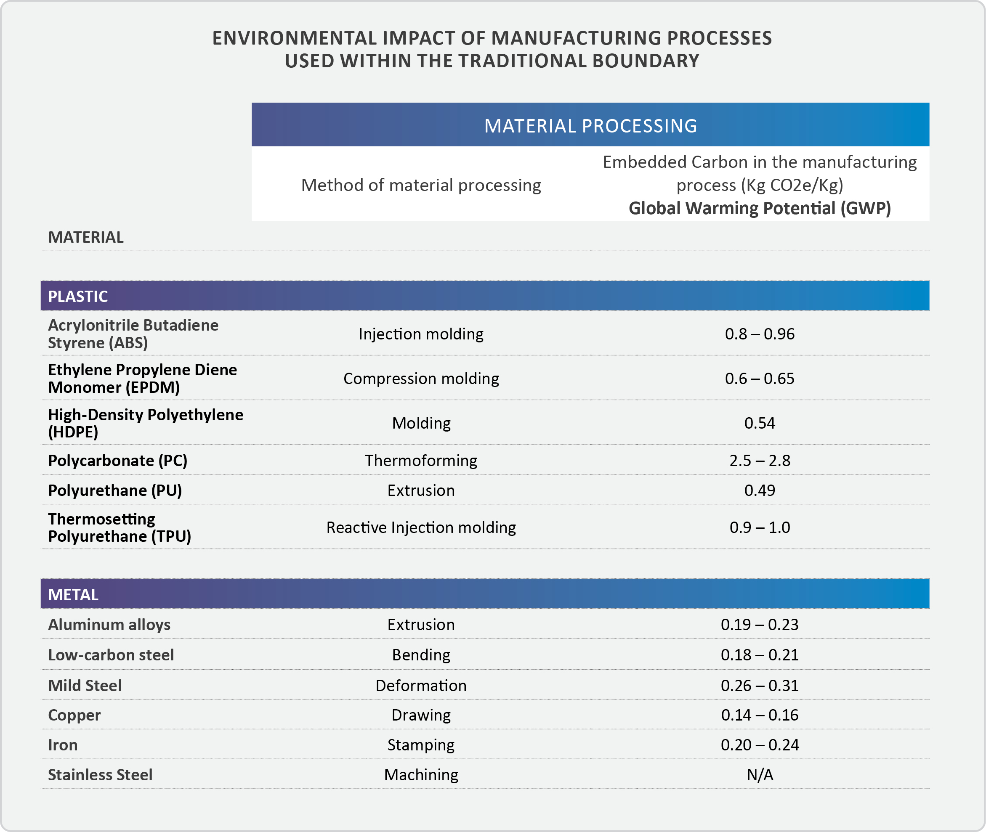
Case Study
Cradle-to-Gate
Comparative Practice
Data-driven, evidence-based value

Slide 4
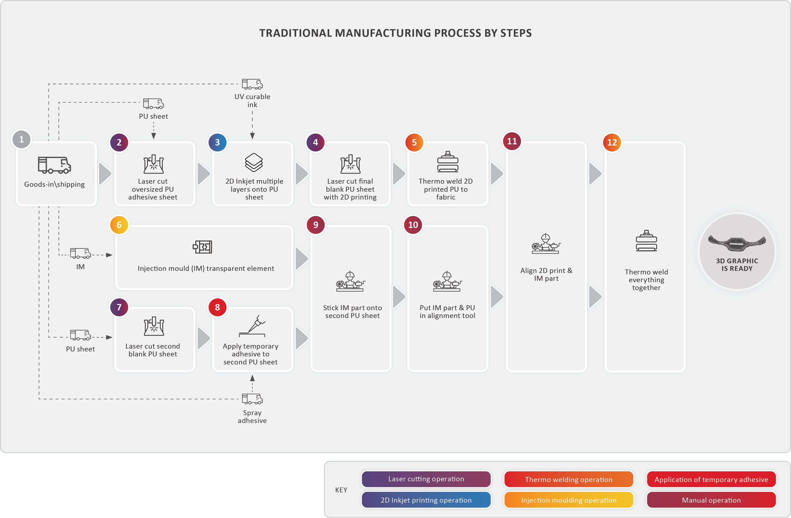
Comparative Practice Proves Value for Customer
Traditional Manufacturing Methods
Additive Manufacturing

Slide 5
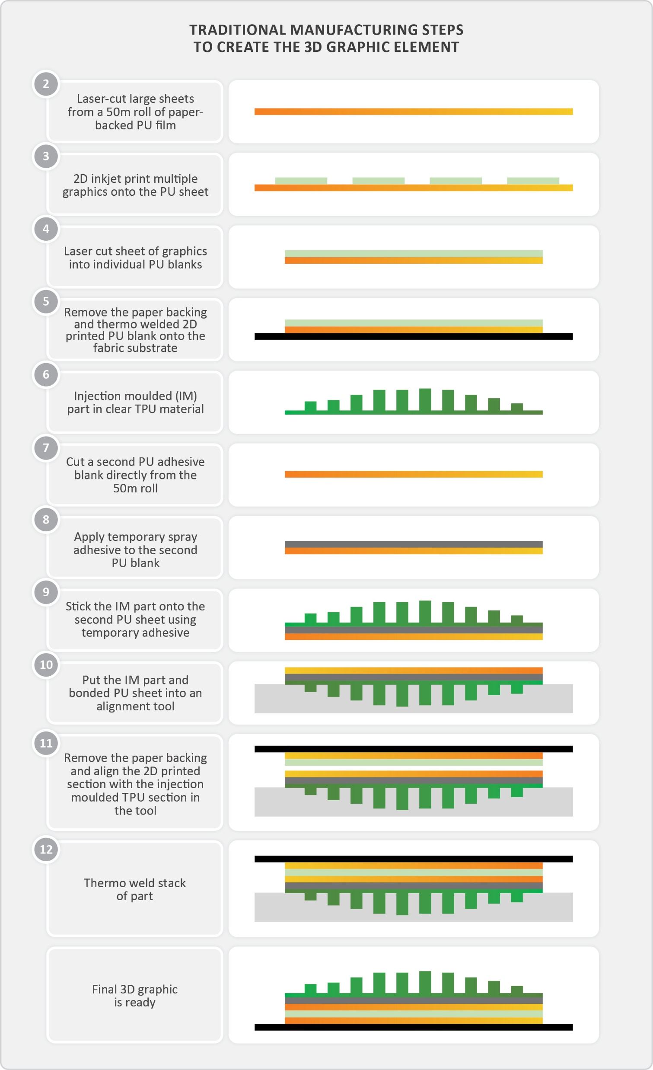
Comparative Practice
Traditional Manufacturing Methods
Additive Manufacturing

Slide 6
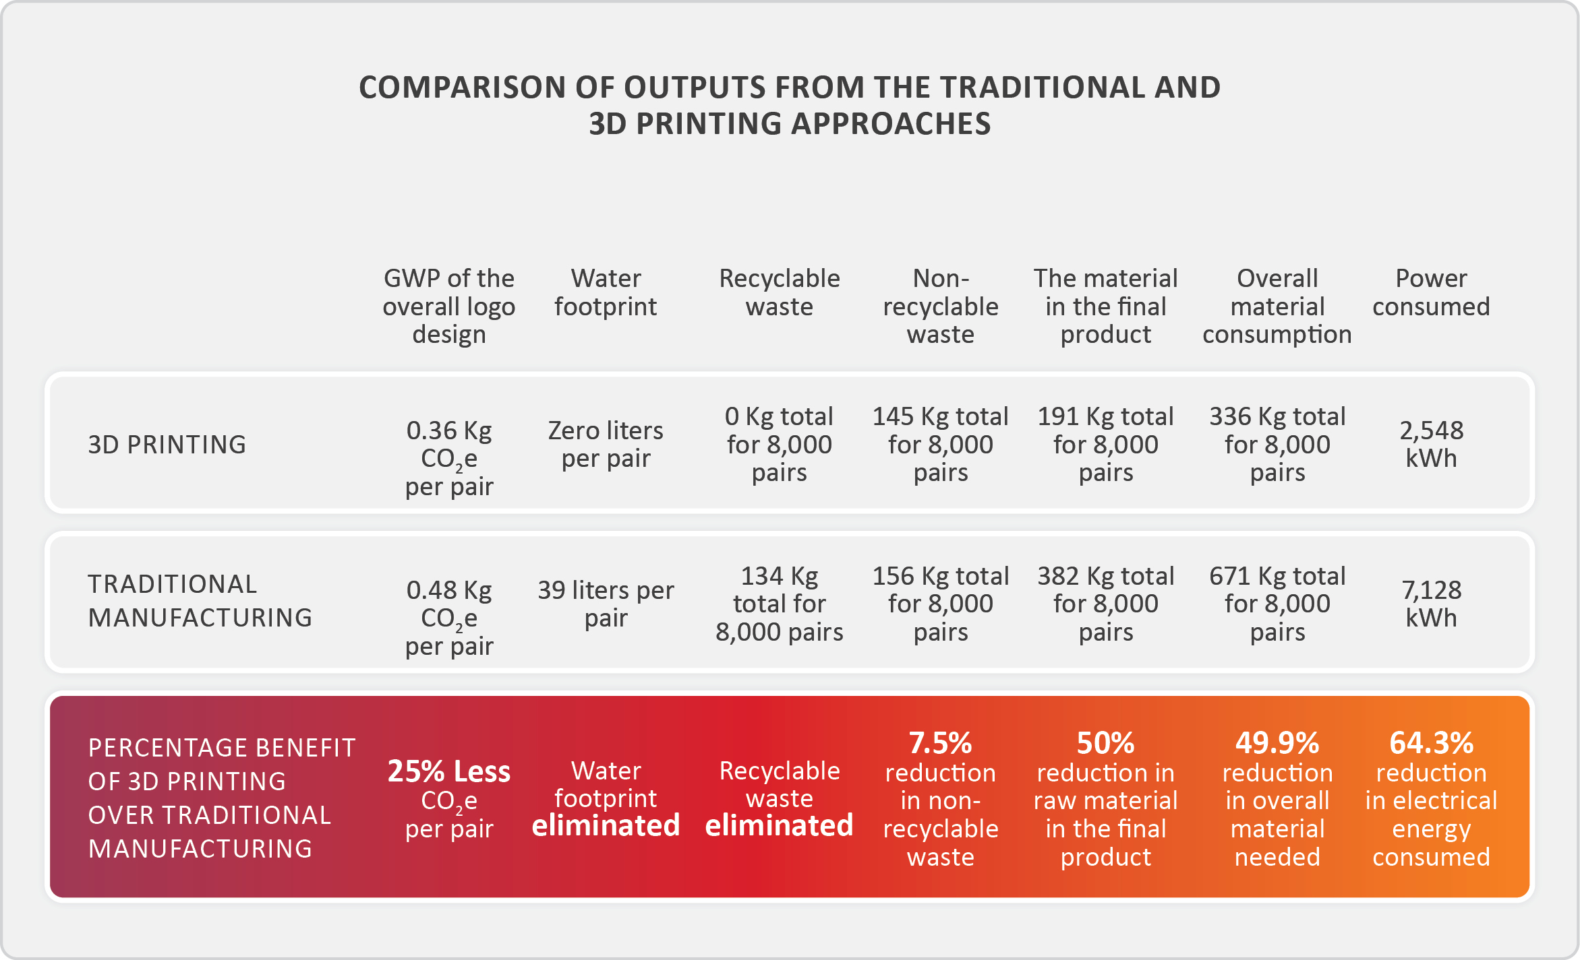
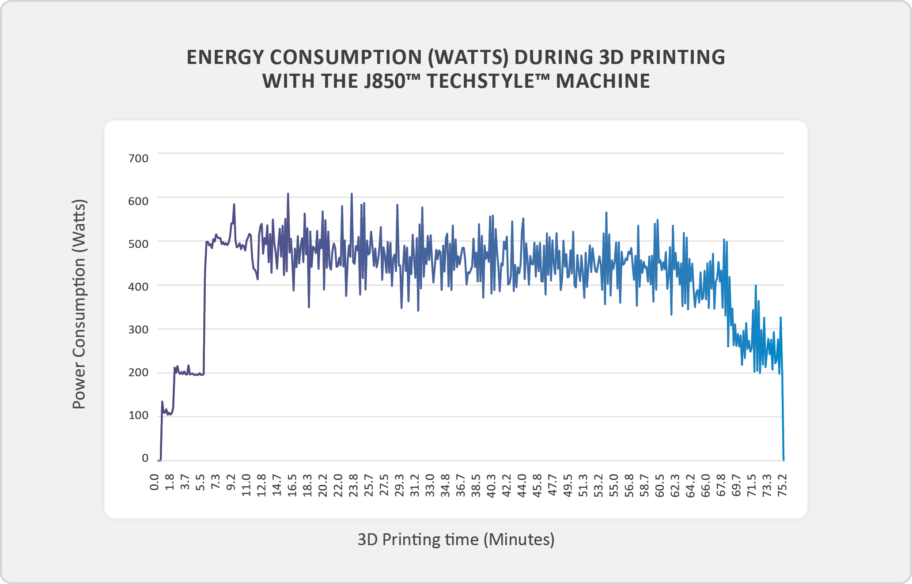
Findings for Use Case: Numbers show real environmental value of AM
24.8% Reduction in Greenhouse Gas Emissions
49.9% Reduction in material usage
300,000 liter Reduction in water usage
64.3% Reduction in electrical energy consumption
4:1 Reduction in supply chain dependencies
12:2 Reduction in process steps

Slide 7
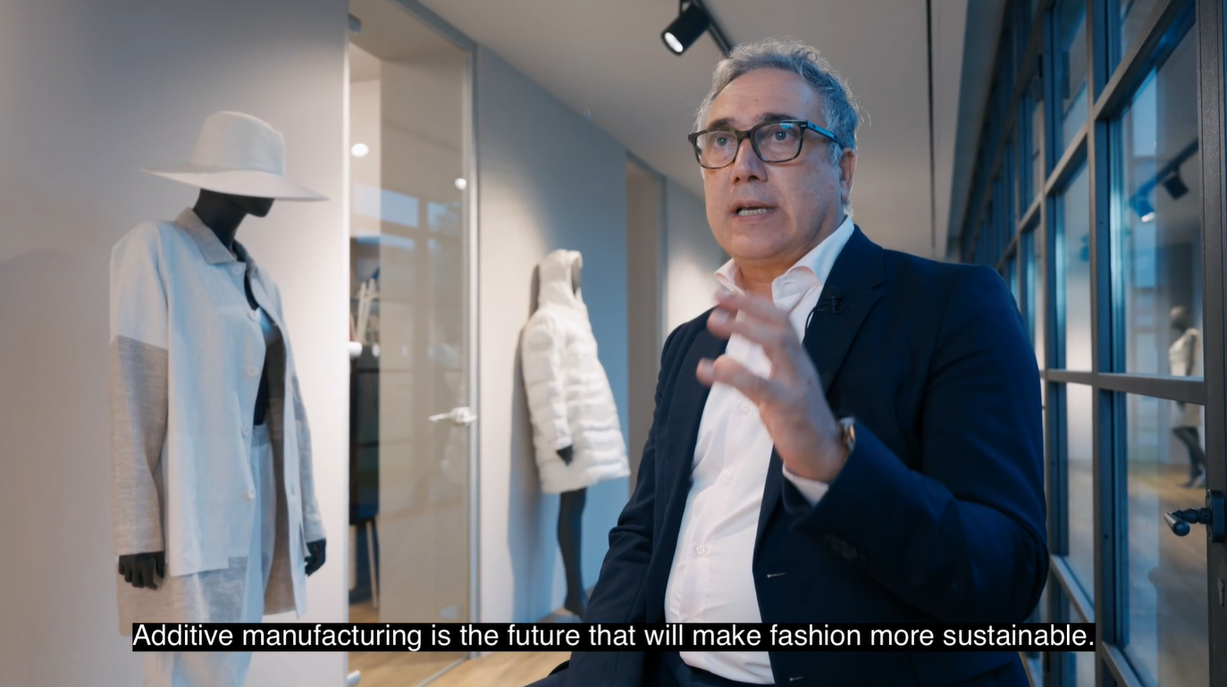
Customer Facing Initiative

